Slide 1
Submitted By Submitted To Name of the Student: Shubham Name of the Guide: Roll No: 35 Dr. Kavita Taneja Class: MCA(M) Designation: Assistant Professor Panjab University, Chandigarh Department: DCSA, PU
PRESENTATION ON JOBSEEKING-WEBSITE
SUNMITTED TO: PANJAB UNIVERSITY, CHANDIGARH
DEPARTMENT OF COMPUTER SCIENCE AND APPLICATIONS
JOBSPRING

Slide 2
ABSTRACT
This project is a job-seeking platform developed using the MERN stack (MongoDB, Express.js, React.js, and Node.js) over a 6-month industrial training period Two user types –job seekers and employers.
Employers can post, edit, and delete jobs, and manage applications through a dedicated dashboard.
Job seekers can browse job listings, apply directly, and track application status in real time.
User-friendly interface designed for smooth navigation and easy interaction.
Real-time updates keep both job listings and applications current.
Application management – Both employers and job seekers can manage job posts and applications flexibly.
Aims to bridge the gap between job seekers and employers by offering an efficient recruitment platform.

Slide 3
CONTENTS
OVERVIEW
OBJECTIVES
HARDAWRE AND SOFTWARE TO BE USED
USER REQUIREMNETS
FLOWCHART
PROJECT DEVELOPMENT
PROJECT IMPLEMENTATION
DATABASE DESIGN
TESTING
CONCLUSION
REFRENCES

Slide 4
OVERVIEW
Jobspring: A web-based job seeking application.
Tech Stack: Built using MERN (MongoDB, Express.js, React.js, Node.js).
Purpose: Streamlines the job search and recruitment process.
User Roles: Separate logins for job seekers and employers.
Key Features:
Job seekers can search, view, and apply for jobs
Employers can post, manage, and review job applications

Slide 5
OBJECTIVES
Implement secure user authentication for both job seekers and employers.
Enable employers to efficiently post, edit, and manage job listings.
Provide job seekers with intuitive tools for job searching, application submission, and application management.

Slide 6
HARDAWARE AND SOFTWARE TO BE USED
HARDWARE
SOFTWARE
2 GB RAM minimum.
2 GB of available disk space minimum,
1280 x 800 minimum screen resolution
Processor: Intel Core i3 CPU @2.00 GHz or later
Visual Studio Code
Chrome/Mozilla Firefox (latest version)
MongoDB (database)
Express.js (back-end framework)
React.js (front-end library)
Node.js (JavaScript runtime)
MongoDB Compass (GUI for MongoDB)

Slide 7
USER REQUIREMENTS
FUNCTIONAL REQUIREMENTS:
1. User Authentication:
• Users must be able to register and login securely.
• Separate login interfaces for job seekers and employers.
2. Employer Functionalities:
• Post Job
• View Posted Jobs
• Edit Job
• Delete Job
• View Applications
3. Job Seeker Functionalities:
• View Available Jobs
• Apply for Jobs
• Delete Application

Slide 8
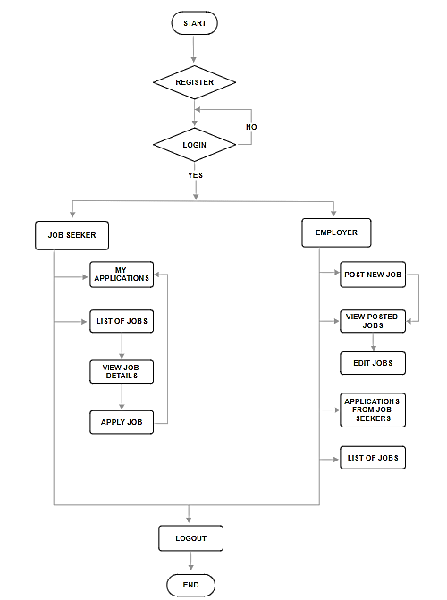
FLOWCHART

Slide 9
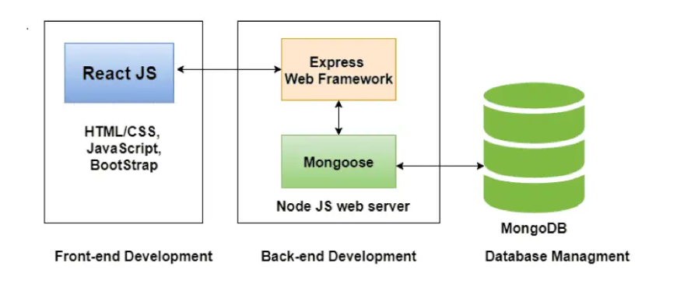
PROJECT DEVELOPMENT

Slide 10
PROJECT IMPLEMENTATION
REGISTRATION:Users are provided with the option to register for a new account if they are not already registered in the system.

Slide 11
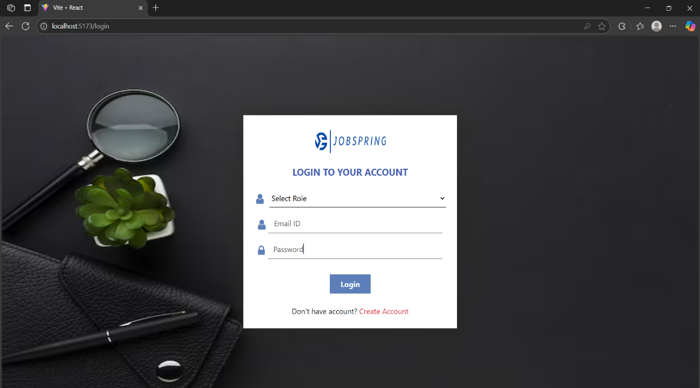
LOGIN PAGE:Users are prompted to authenticate/login to their account using their registered credentials (email and password) . If the user is not registered (No), the flow returns to the registration step to allow the user to complete the registration process.

Slide 12
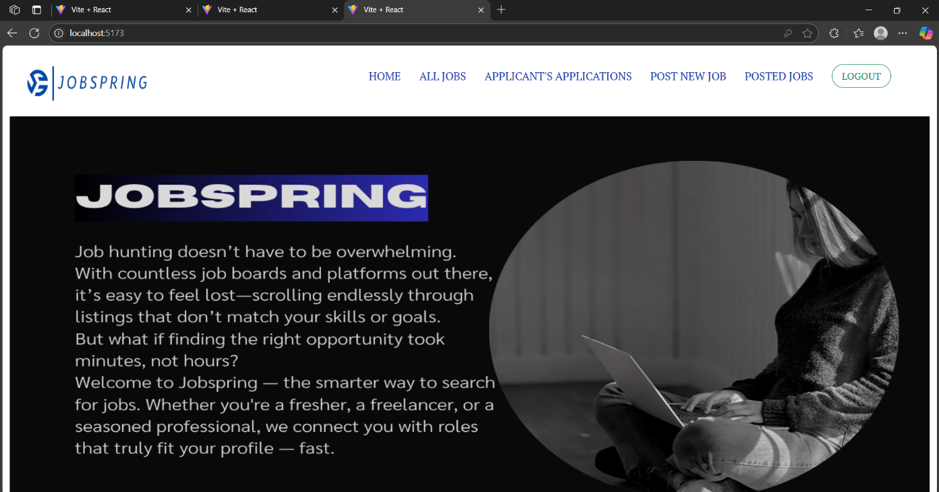
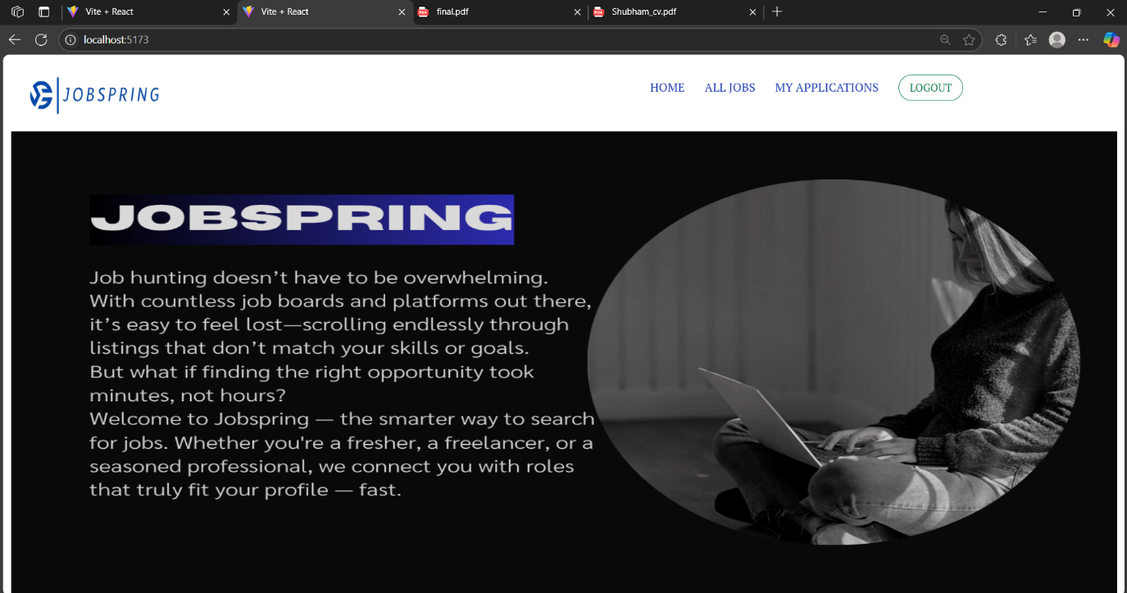
Employer dashboard :If the user successfully authenticates as an employer, they gain access to the employer functionalities provided by the system.
Job seeker dashboard: If the user successfully authenticates as a job seeker, they gain access to the job seeker functionalities provided by the system.

Slide 13
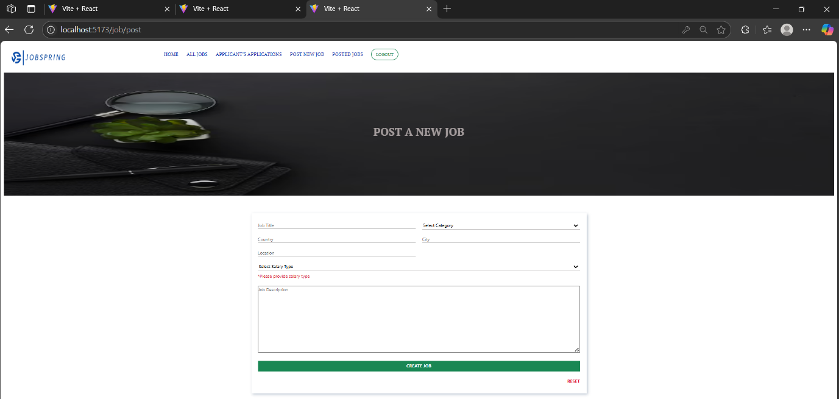
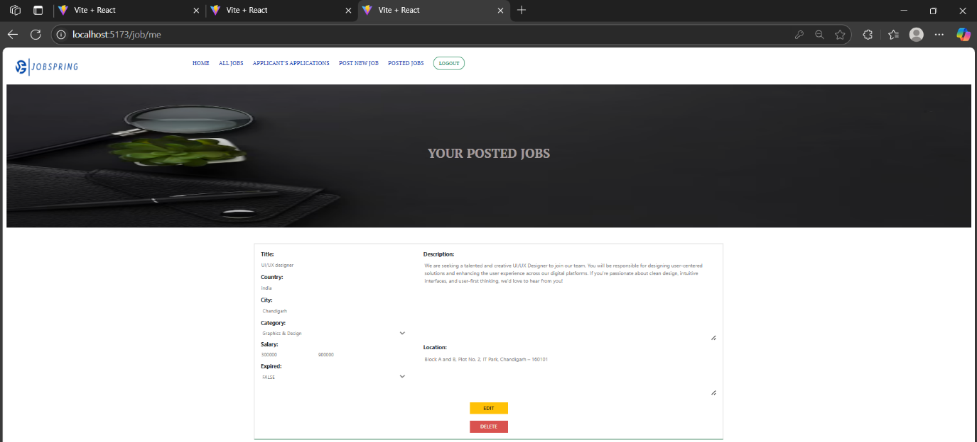
Post jobs: Employers have the capability to create and publish new job listings within the system, providing details such as job title, description, requirements, etc.
Post jobs: Employers have the capability to create and publish new job listings within the system, providing details such as job title, description, requirements, etc.
Edit Jobs: Employers can modify and update existing job listings they have posted within the system, allowing them to keep the job information current and accurate.

Slide 14
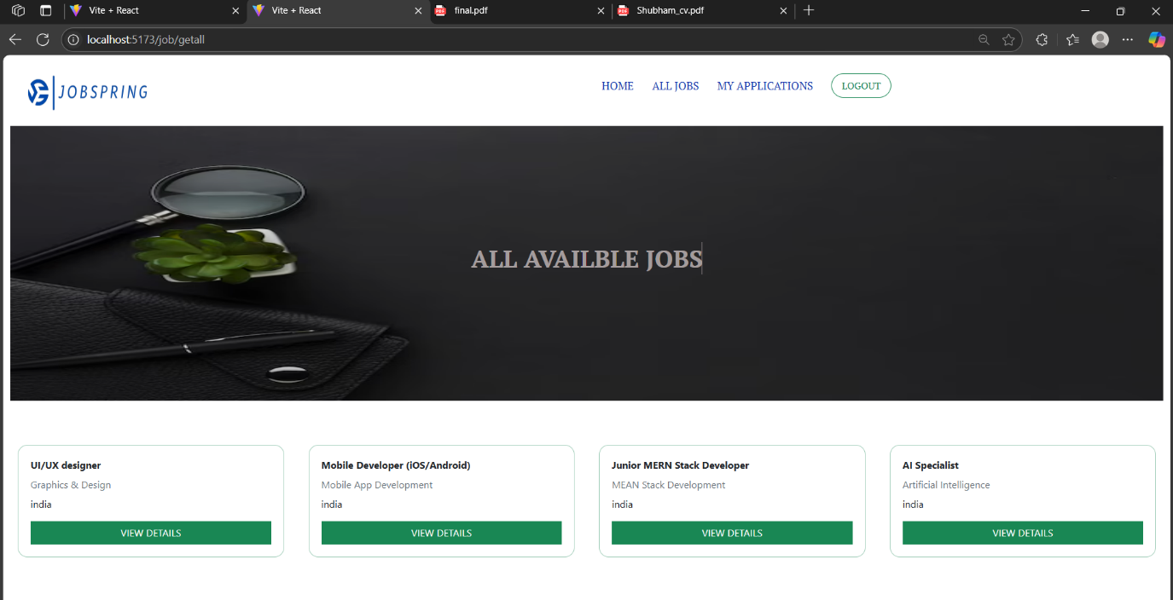
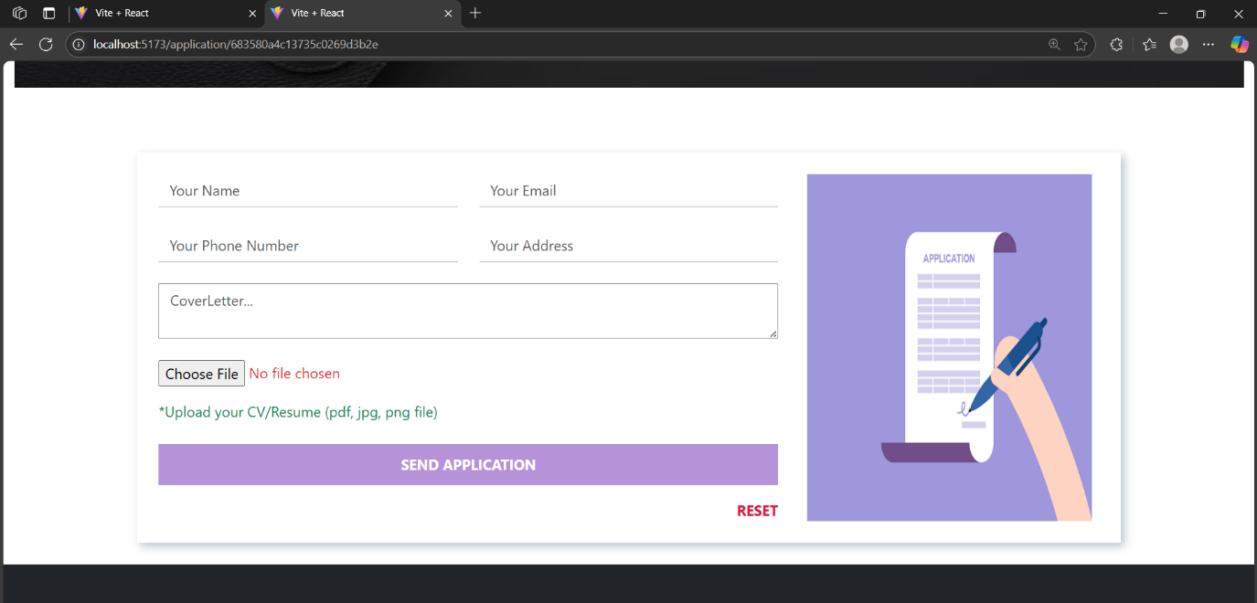
List of jobs:Job seekers can explore and view available job listings posted by employers within the system
Apply for jobs : Job seekers can submit applications for specific job listings they are interested in, providing their relevant details and qualifications.

Slide 15
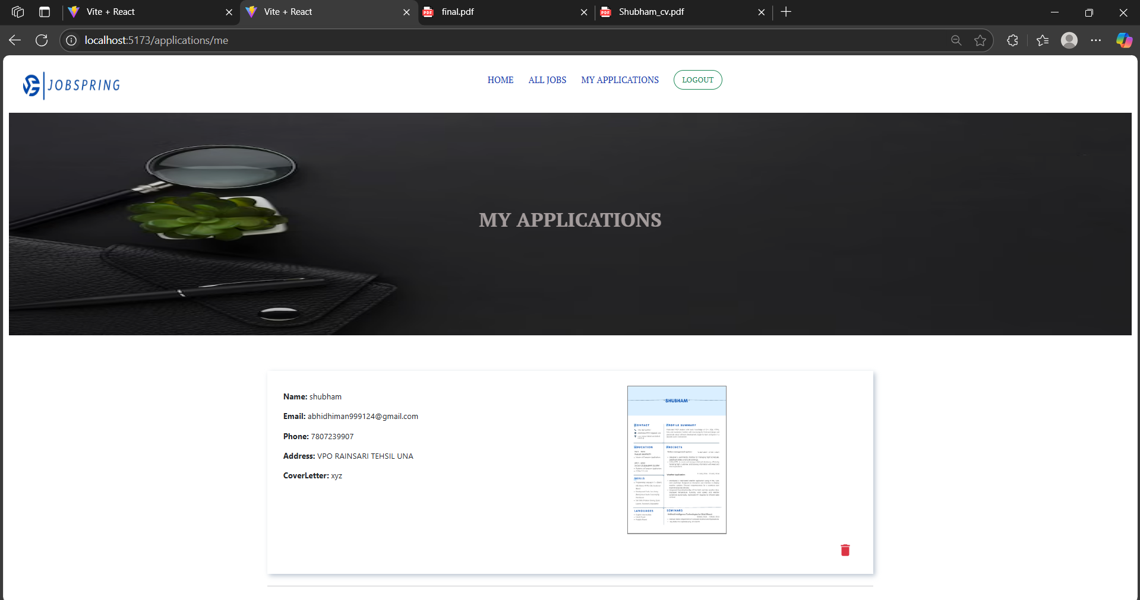
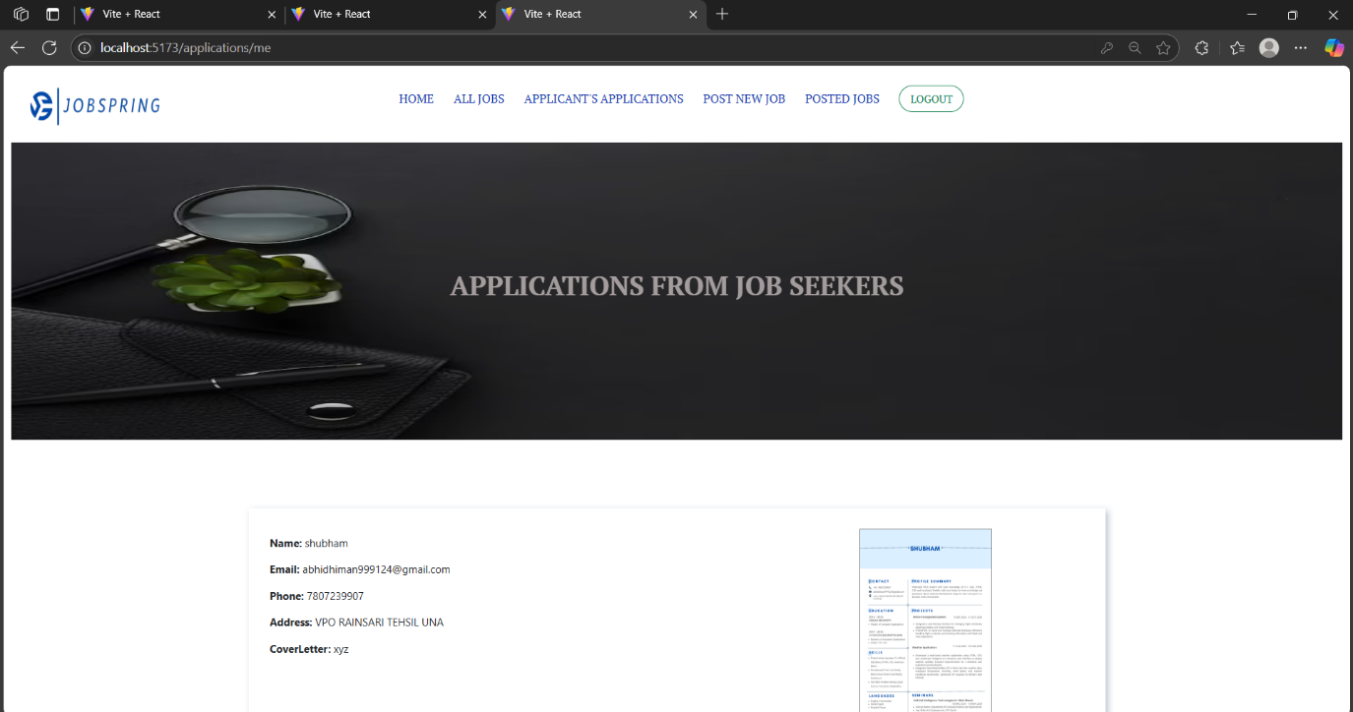
Manage Applications: Both job seekers and employers have access to features for managing job applications. Job seekers can view the status of their submitted applications, withdraw applications if necessary, and track their application history. Employers can review incoming job applications and manage the application process for their job listings.
Job Seeker
Employer

Slide 16
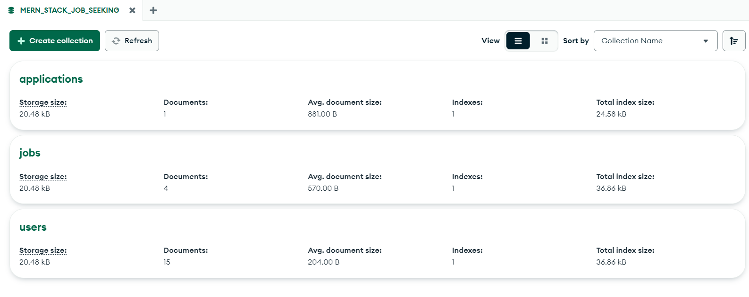
DATABASE DESIGN-MongoDB
The database for Jobspring is organized into several collections, each serving a specific purpose :
User Collection
Jobs Collection
Application Collection

Slide 17
DATABASE DESIGN-MongoDB
User Collection:Stores user registration and authentication details, including roles for access control.
Jobs Collection: Manages job listings with essential details like titles, descriptions, and posting dates.
Applications Collection: Tracks job applications submitted by users, storing applicant details and related job information.

Slide 18
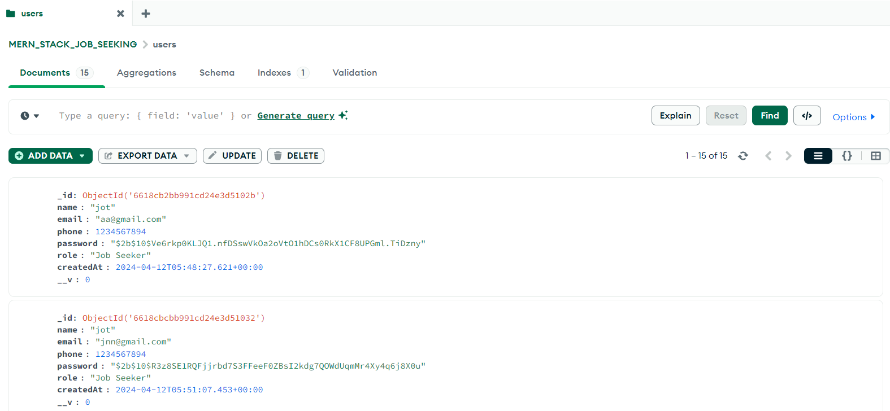
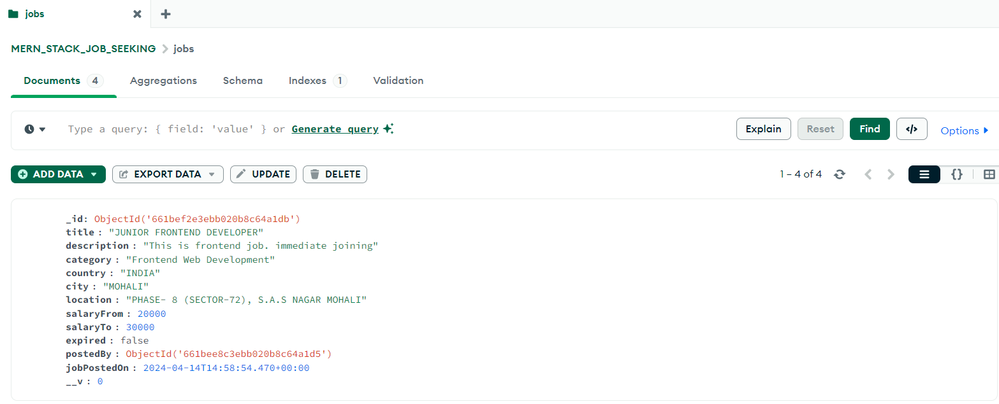
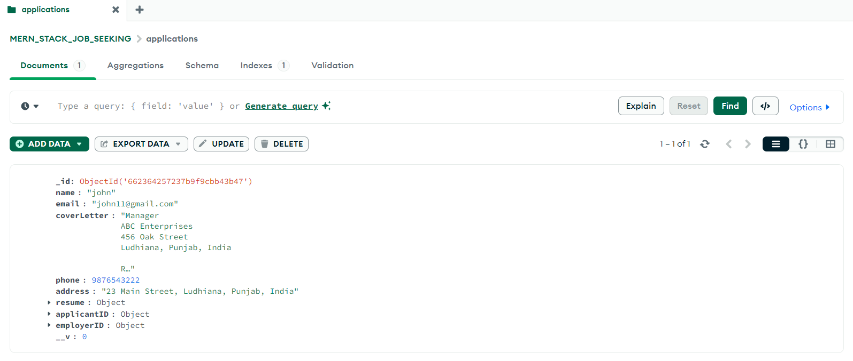
Database

Slide 19
TESTING
Check all required fields are filled (name, email, phone, password)
Validate email format
Verify password strength (length, special characters)
Register with valid and invalid credentials
Check for duplicate email errors
User Registration Test Cases
User Login Test Cases
Login with correct credentials
Test wrong email/password
Login with correct email but wrong password
Try logging in with unregistered email
Check blocked login for unverified accounts

Slide 20
Job Posting Test Cases
Job Application Test Cases
Post a job with all required details
Handle missing/invalid info (e.g., empty title, wrong salary)
Verify job shows on job board
Edit job and confirm updates
Delete job and ensure it’s removed
View job listings
Apply with valid resume and cover letter
Test applying without attachments
Confirm applications are saved in database

Slide 21
CONCLUSION
JobSpring provides a unified solution that bridges the gap between talent and hiring companies..
Built on the MERN stack (MongoDB, Express.js, React.js, Node.js) for robust and scalable performance.
Core functionalities include:
Smooth job searching experience.
Smooth and fast application process.
Effective tools for managing applications.
Delivers a secure, responsive, and user-friendly experience across all devices.
Accelerates the job search and hiring process for both candidates and recruiters.
Thoroughly tested and validated to ensure high reliability, performance, and user satisfaction.

Slide 22
REFRENCES
MongoDB Documentation https://www.mongodb.com/docs/ Official documentation for MongoDB database usage and design.
Node.js Documentation
https://nodejs.org/en/docs/
Comprehensive guide for building backend applications using Node.js.
Express.js Guide https://expressjs.com/ Reference for building RESTful APIs and routing with Express.js.
React.js Documentation https://reactjs.org/docs/getting-started.html Official React documentation for building user interfaces and components.
MDN Web Docs (HTML, CSS, JavaScript) https://developer.mozilla.org/ Reliable reference for core web technologies used in frontend development.
W3Schools Web Development Tutorials https://www.w3schools.com/

